Slide 1
Algorithms used in Optimal Feeding
By Boyi Guo(boyiguo1)

Slide 2
General View of Optimal Feeding
Current feeding animal with unrestricted feeding
Come up with solutions that improve feeding strategies to get maximum profit.
3 variable to plot a 3D surface: Feeding rate, animal size, time.
Finally get a optimal feeding solution based on facility and feed costs and discount rates.
More details will be given by my team mate.

Slide 3
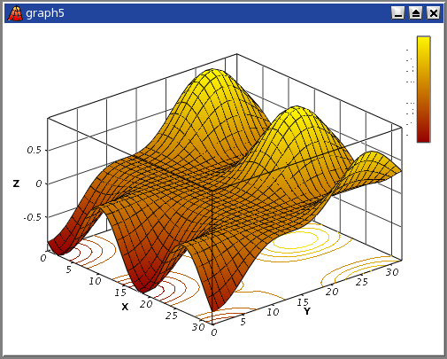
3D-plot

Slide 4
Problem
Reduce this problem to a problem that finds a minimal weighted path
  Cut whole 3d surface to small grids, and every grid will have a weight
  Every adjacent grids have weight between them, which will be based on the cost function.
  We have a whole graph with weights on edge.

Slide 5
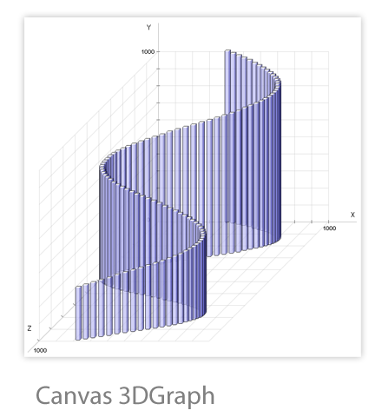
Optimal Path

Slide 6
Algorithms overview
Dynamic Programming (brute force)
Dijkstra’s Algorithm
Kruskal’s Algorithm
Greedy Algorithm

Slide 7
Dynamic Programming
Brute force
The days keep a animal is 24 * 30
The weight will at most 500 lb
The food ate by animal should be constant
There are finite possible results

Slide 8
Dijkstra’s Algorithm
Introduction
  Breadth first search with update the weight on the vertex.
  This could record the minimum cost
  Need one more queue to record the node

Slide 9
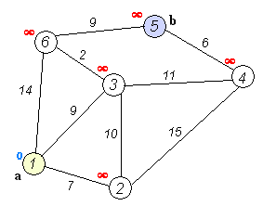
Dijkstra’s algorithm

Slide 10
Kruskal’s Algorithm
Introduction
  Find the edge with minimum weight
  Marked out 2 end points
  Recursively do this until there is a tree formed
  That’s tree should be the minimum cost
  Drawback: not sure where is the end point

Slide 11
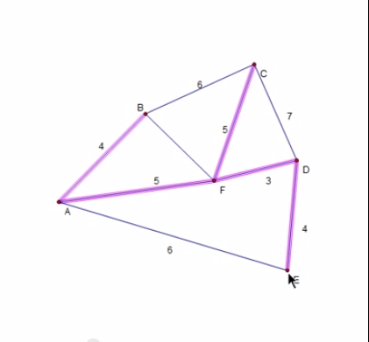
Kruskal’s Algorithm

Slide 12
Greedy Algorithm
The Kruskal’s Algorithm is a greedy algorithm
However, we should improve it.
Besides, we could design our own algorithm based on these algorithms
There are still many constraint on cost function that could help us to make choice

Slide 13
Q & A

Slide 14
The End
Thank you !

